Slide 1
Disaster Tweet Classification using NLP(Deep Learning Project | Real-time Emergency Detection)
CHETHANA S S
NEXTHIKES IT SOLUTIONS

Slide 2
Project Objectives
✓ Develop an accurate tweet classification model.
✓ Ensure high precision to reduce false alarms.
✓ Handle language variations and slang.
✓ Deploy a scalable, real-time monitoring solution.

Slide 3
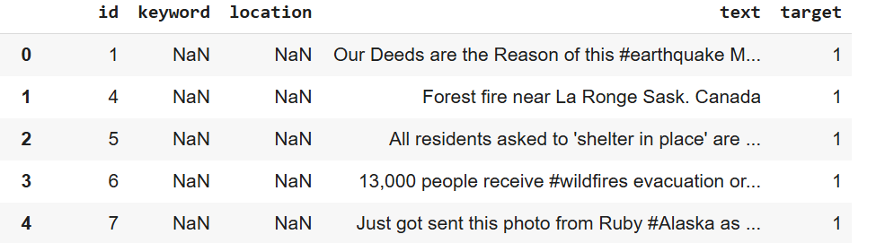
Part 1: Data Exploration
• Loaded 10,000 hand-classified tweets.
• Analyzed structure using pandas.
• Visualized class distribution and keyword frequency.

Slide 4
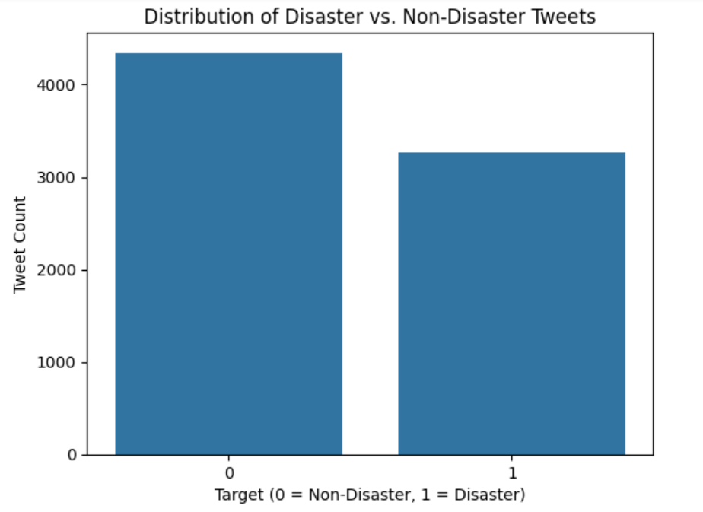
Visualize Class Distribution (Disaster vs. Non-Disaster Tweets)

Slide 5
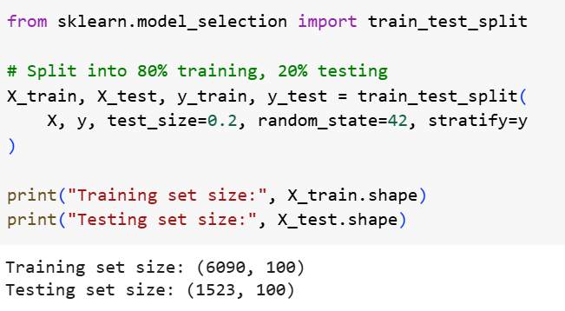
Part 2: Data Preparation
• Cleaned tweets (URLs, punctuation, etc.).
• Tokenized and labeled the data (0 = non-disaster, 1 = disaster).
• Split into training and testing datasets.

Slide 6
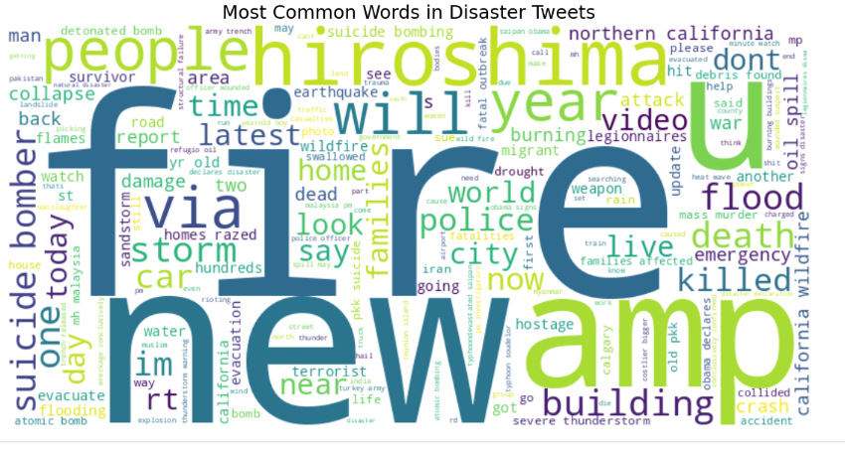
Most Common Words in Disaster Tweets

Slide 7
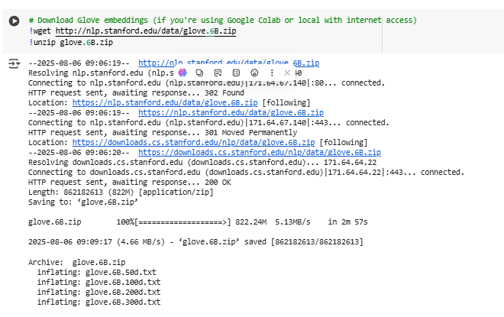
Part 3: Feature Engineering
• Extracted TF-IDF scores and word frequencies.
• Used pre-trained embeddings (GloVe, Word2Vec).
• Added features like tweet length, hashtags, mentions.

Slide 8
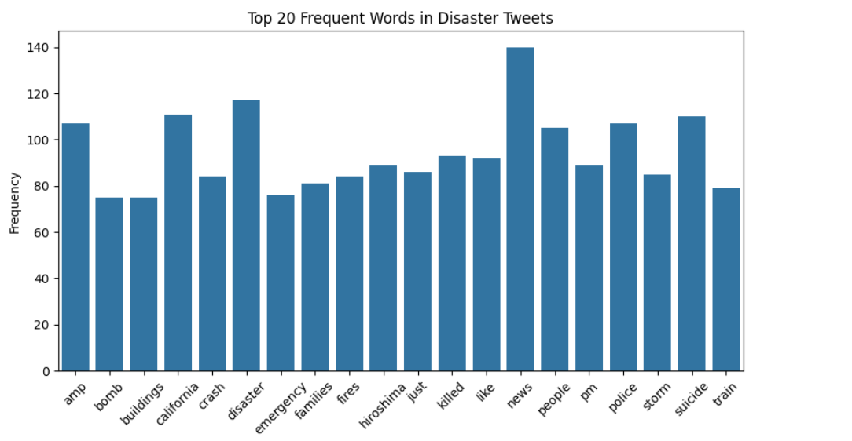
Top 20 Frequent Words in Disaster Tweets

Slide 9
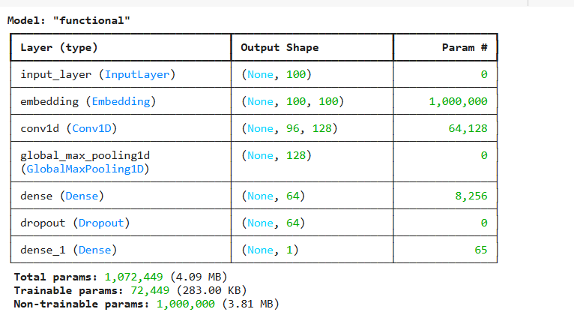
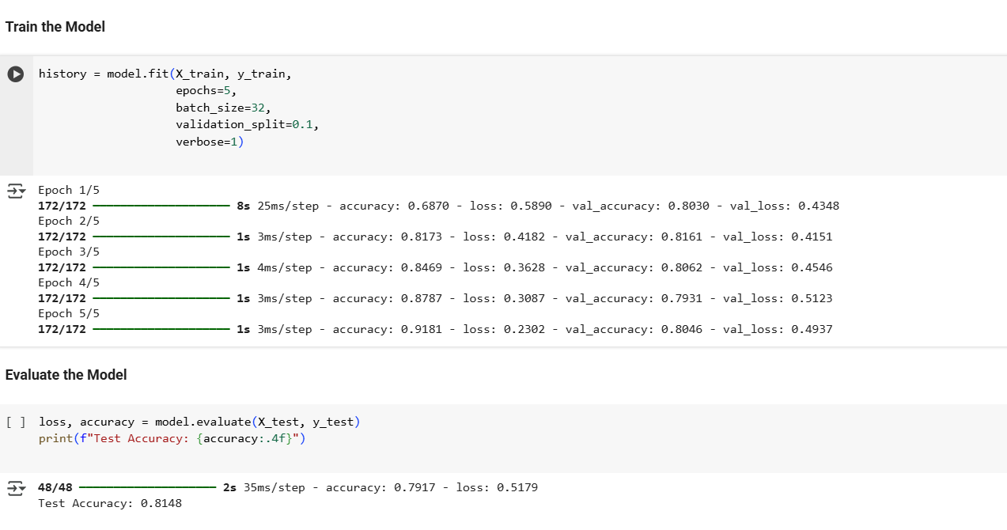
Part 4: Model Selection & Training
• Tried and Build the CNN Model.
• Used cross-validation for performance comparison.
• Tuned hyperparameters with Grid Search.

Slide 10
Part 5: Deployment
• Serialized model using Pickle.
• Built web app with Streamlit.
• Integrated backend for live tweet predictions.
• Deployed on Hugging Face/Heroku/AWS.

Slide 11
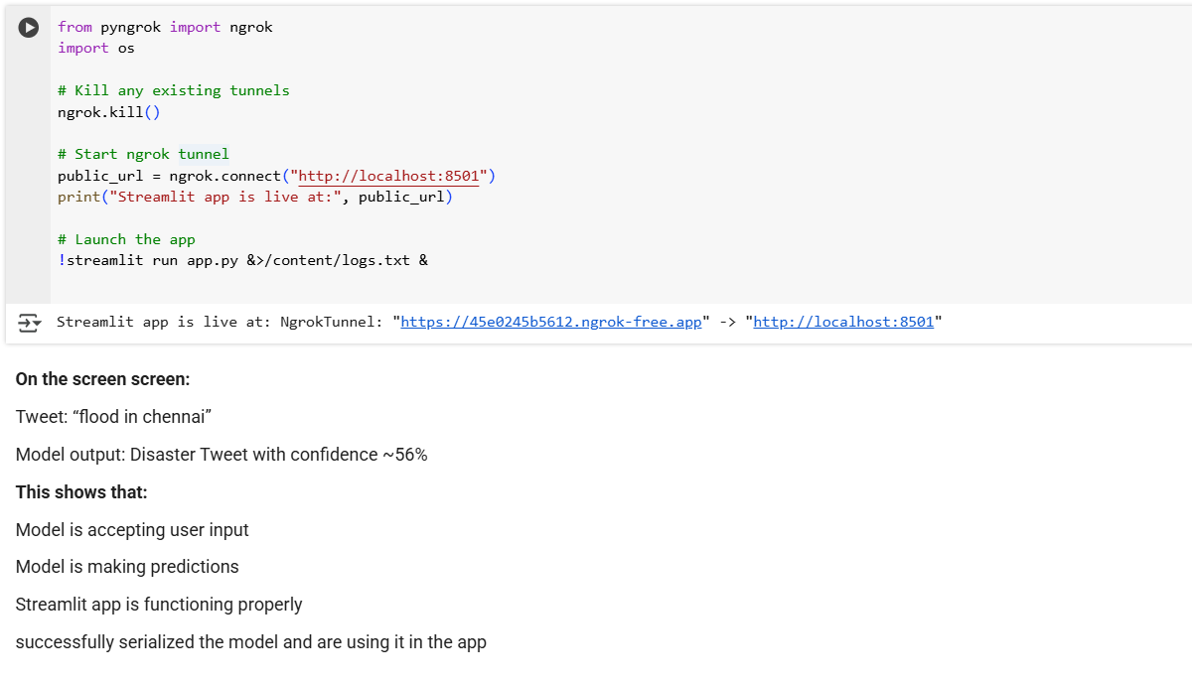

Slide 12
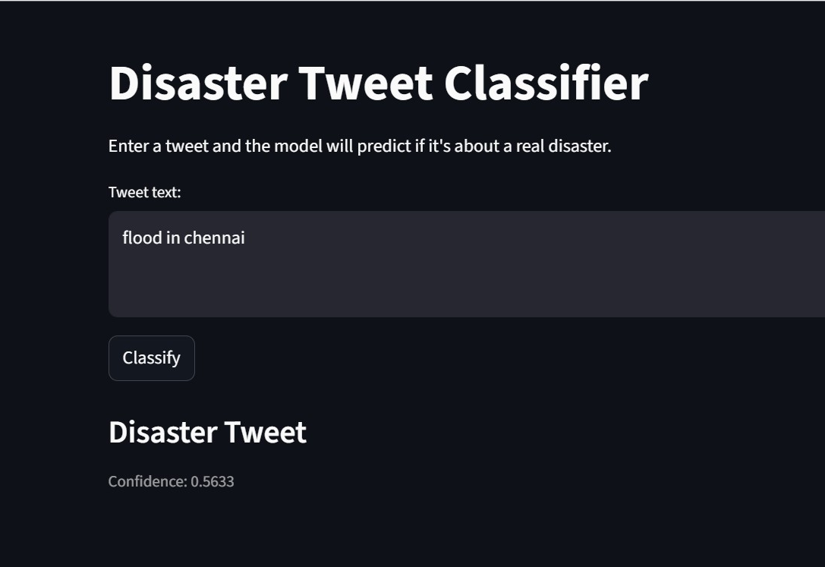

Slide 13
THANKS

